Slide 1
Aircraft Linked System

Slide 2
Electrical Application
by JIA Baohui
中国民航大学 航空工程学院
贾宝惠
24092408;13752593611
jiabaohui@sina.com
Feb,2012

Slide 3
CONTENTS
PART1 LIGHTING
PART2 FIRE PROTECTION

Slide 4
PART1 LIGHTING
TOPICS:
1.1 GENERAL
1.2 EXTERNAL LIGHTING
1.3 INTERNAL LIGHTING
1.4 EMERGENCY LIGHTING

Slide 5
1.1 GENERAL
Lighting plays an important role in the operation of an aircraft and many of its systems, and in the main falls into two groups:
External Lighting:
-The marking of an aircraft’s position by means of navigation lights.
-Position marking by means of flashing lights.
-Forward illumination for landing and taxiing.
-Illumination of wings and engine air intakes to check for icing.
-Illumination to permit evacuation of passengers after an emergency landing.
Internal Lighting:
-Illumination of cockpit instruments and control panels.
-Illumination of passenger cabins and passenger information signs.
-Indication and warning of system operating conditions.

Slide 6
1.2 EXTERNAL LIGHTING
The exterior lights supply light for airplane identification, direction, and to aid in the safe operation of the airplane.
Generally, exterior lights on the airplane include:
Landing lights
Taxi and runway turnoff lights
- Navigation lights
- Anti-collision lights
- Wing lights
- Logo lights.

Slide 7
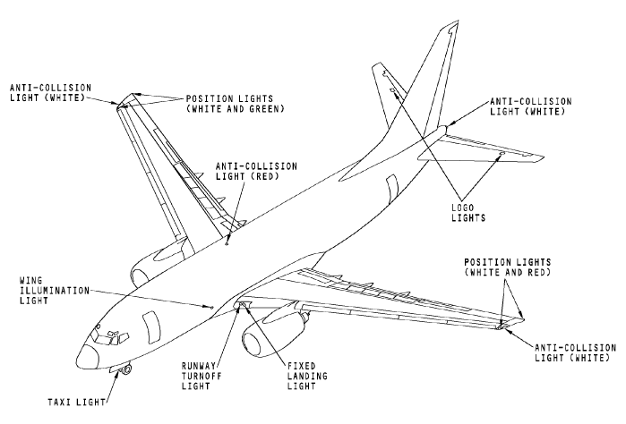
1.2 EXTERNAL LIGHTING continuation1
The following plan view of external lighting is based on the Boeing737 and, although not all the lights shown would be standard on all other types of aircraft, it serves to illustrate the disposition of external lights generally.

Slide 8
1.2 EXTERNAL LIGHTING continuation2
LANDING LIGHTS AND TAXI LIGHTS provide essential illumination for the landing of an aircraft and for taxiing it to and from runways and terminal areas at night and at other times when visibility conditions are poor. Landing lights are so arranges that they illuminate the runway immediately ahead of the aircraft from such positions as wing leading edges, front fuselage sections and nose landing gear structure.
Runway turn-off lights are equipped in some of the larger types of transport aircraft, their primary function is to illuminate the points along the runway at which an aircraft must turn to leave the runway after landing.

Slide 9
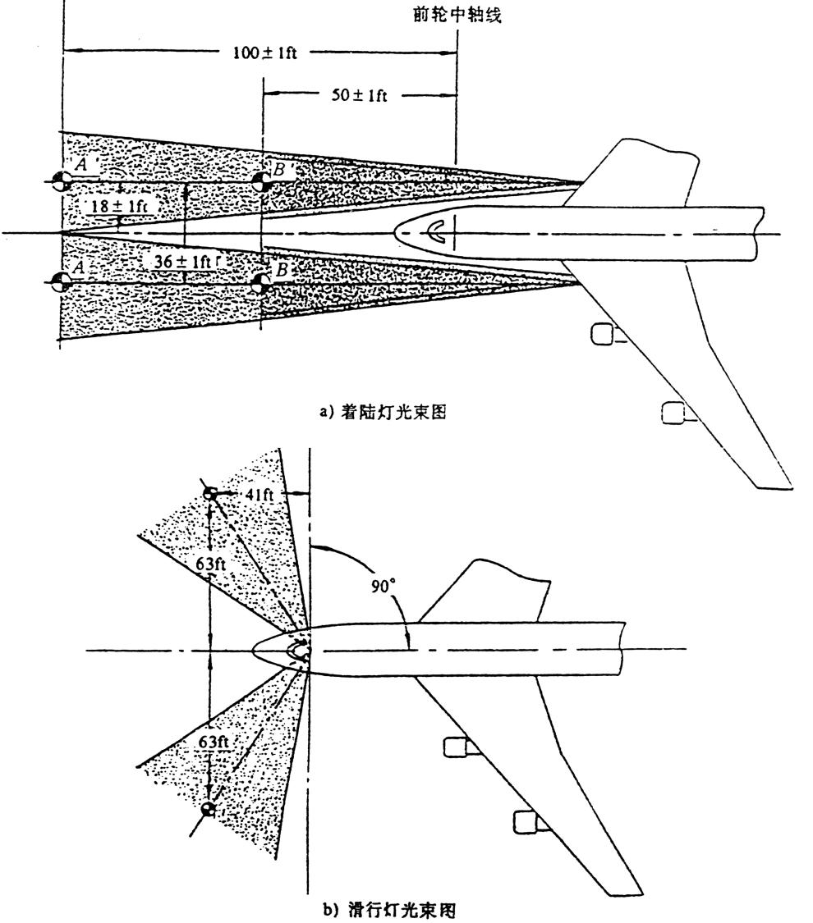
1.2 EXTERNAL LIGHTING continuation3

Slide 10
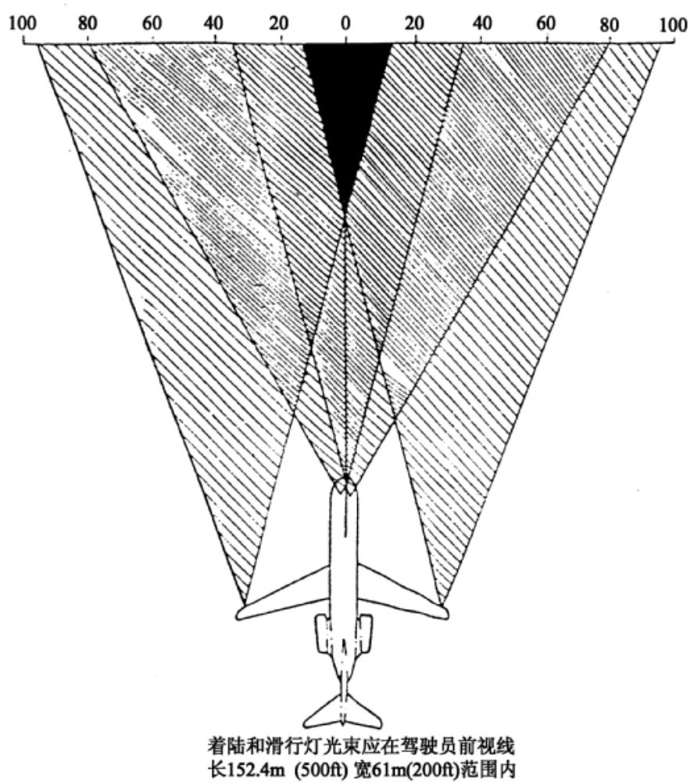

Slide 11
1.2 EXTERNAL LIGHTING continuation4
NAVIGATION LIGHTS
The requirement and characteristics of navigation lights are agreed on an international basis and are set out in the statutory Rules of the Air and Orders for Air Navigation and Air Traffic Control regulations. Briefly, these requirements are that every aircraft in flight or moving on the ground during the hours of darkness shall display:
A green light at or near the right wing tip ;
A red light at or near the left wing tip;
A white light visible from the rear of the aircraft.
The conventional location of this light is in the aircraft’s tail, but in certain cases, such as B737, white lights are mounted in the trailing edge sections of each wing tip.

Slide 12
1.2 EXTERNAL LIGHTING continuation5
ANTI-COLLISION LIGHTS
Anti-collision lights also fulfils a position marking function and make the airplane easier to see in the air and on the ground.
Generally, there are two red anti-collision lights on the airplane. One red anti-collision light is on the top and bottom of the fuselage.

Slide 13
1.2 EXTERNAL LIGHTING continuation6
ICE INSPECTION LIGHTS
Ice inspection or wing-scan lights are fitted to most types of transport aircraft, to detect the formation of ice on the leading edges of wings and also at the air intakes of turbine engines.

Slide 14
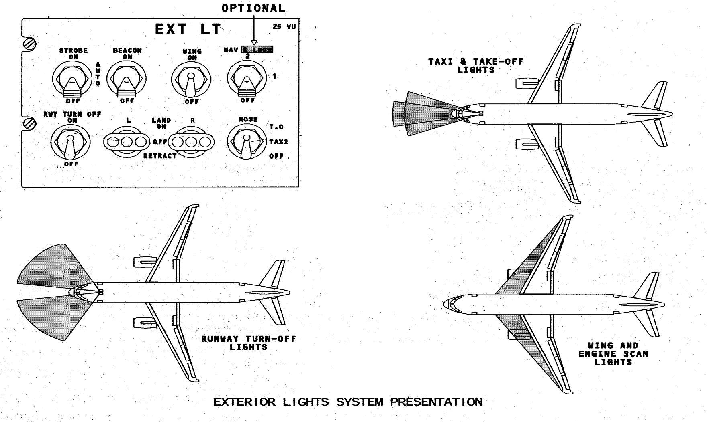
1.2 EXTERNAL LIGHTING continuatio7

Slide 15
1.3 INTERNAL LIGHTING
The interior lights of aircraft can be broadly divided into three categories:
- Cockpit or operational lighting
- Passenger cabin lighting
- Serving lighting which includes galleys, toilet compartments, freight compartments and equipment bays.

Slide 16
1.3 INTERNAL LIGHTING continuation1
COCKPIT LIGHTING
The most important requirements for cockpit lighting are those necessary to ensure adequate illumination of all instruments, switches, controls, etc., and of the panels to which these items are fitted. Some of the methods adopted to meet these requirements are as follows:
Integral lighting
Pillar and bridge lighting
Flood-lighting

Slide 17
INTEGRAL LIGHTING
The principal form of integral lighting for instruments is that known as wedge or front lighting; a form deriving its name from the shape of the two portions which together make up the instrument cover glass.
PILLAR AND BRIDGE LIGHTING
Pillar lighting, so called after the method of construction and attachment of the lamp, provides illumination for individual instruments and controls on the various cockpit panels. A typical assembly, shown in Fig.10.9, consists of a miniature center-contact filament lamp inside a housing, which is a push fit into the body of the assembly.
FLOOD-LIGHTING
Flood-lighting is used for the general illumination of instruments, control panels, pedestals, side consoles and areas of cockpit floors. The lights usually take the form of incandescent lamp units and fluorescent tube units and depending on the type of aircraft, both forms may be used in combination.

Slide 18
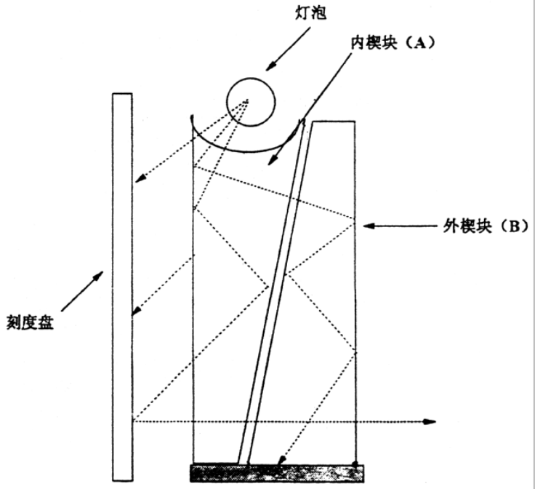
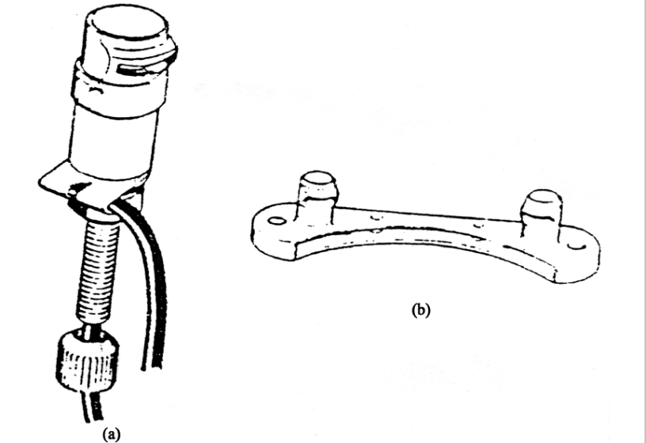
Wedge type lighting
Pillar and bridge lighting

Slide 19
1.3 INTERNAL LIGHTING continuation2
Flight compartment lights:
- Instrument and panel lights
- Miscellaneous lights
- Flight crew lights
- Master dim and test.
The master dim and test system controls the light for the system annunciator and indicator lights.
- Test the indicator and panel lights
- Cause the indicator and panel lights to come on in the bright or dim mode.

Slide 20
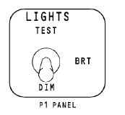
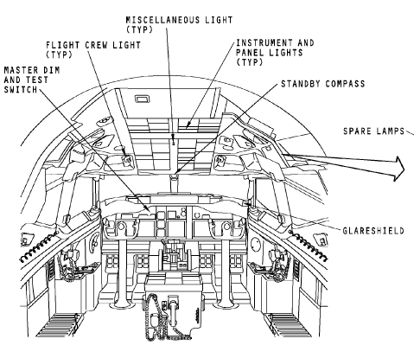

Slide 21
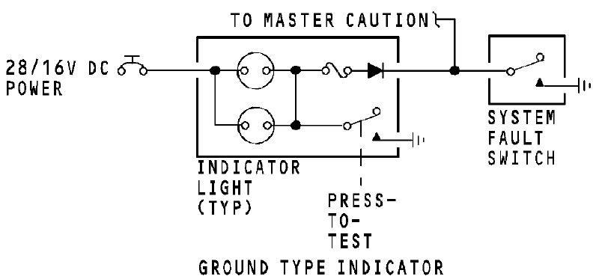
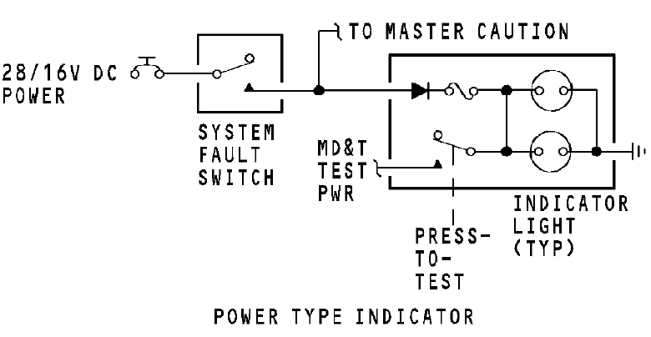
INDICATOR LIGHTS

Slide 22
1.3 INTERNAL LIGHTING continuation3
PASSENGER CABIN LIGHTS
The lights in the passenger compartment supply these functions:
- General light in the passenger cabin
- Reading lights
- Information lights for the passengers and attendants
- Lights in the lavatories
- Lights in the galleys.
The light system also lets the passenger call the attendants for aid.

Slide 23
1.3 INTERNAL LIGHTING continuation4
The passenger compartment lights has these subsystems:
- Window lights
- Ceiling lights
- Reading lights
- Passenger signs
- Lavatory lights and signs
- Passenger and lavatory call lights
- Attendant work lights
- Galley lights
- Entry lights.

Slide 24
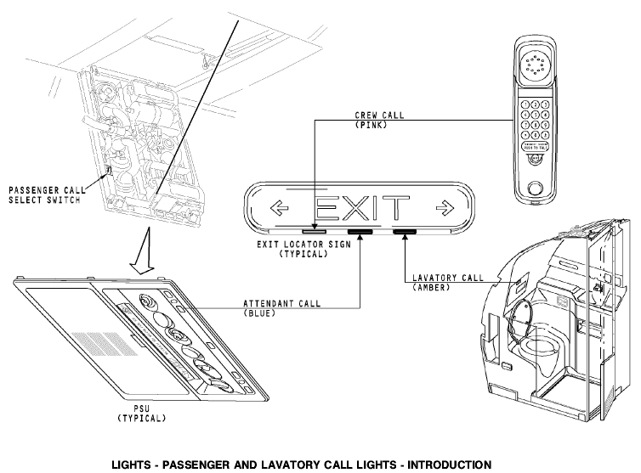

Slide 25
1.3 INTERNAL LIGHTING continuation5
Cargo and service compartment lights
The cargo and service compartment lights supply light to help maintenance personnel and ground crews.

Slide 26
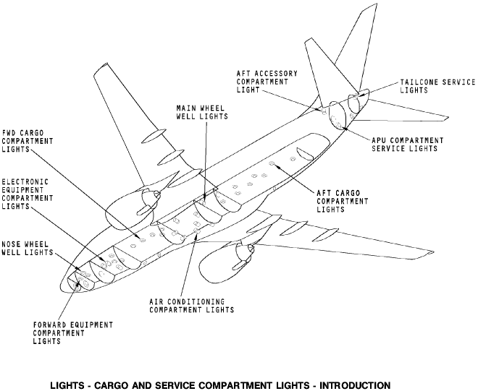
1.3 INTERNAL LIGHTING continuation6

Slide 27
1.4 EMERGENCY LIGHTING
EMERGENCY LIGHTS
An essential requirement concerning lighting is that adequate illumination of the cockpit and the various sections of the cabin, exits, escape hatches, chutes etc., must be provided under emergency conditions, e.g. a crash-landing at night. So the emergency lighting system puts lights on areas inside and outside of the airplane and the exit paths.
The illumination is normally at a lower level than that provided by the standard lighting systems, since the light units are directly powered from an emergency battery pack or direct from the aircraft battery in some cases. The batteries are normally of the nickel-cadmium type although in some aircraft silver-zinc batteries are employed.

Slide 28
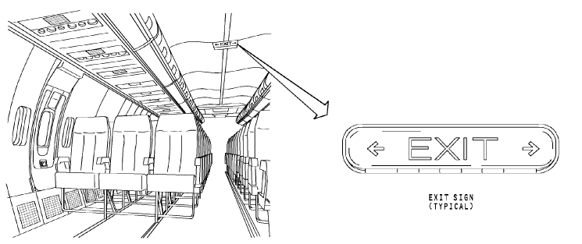

Slide 29
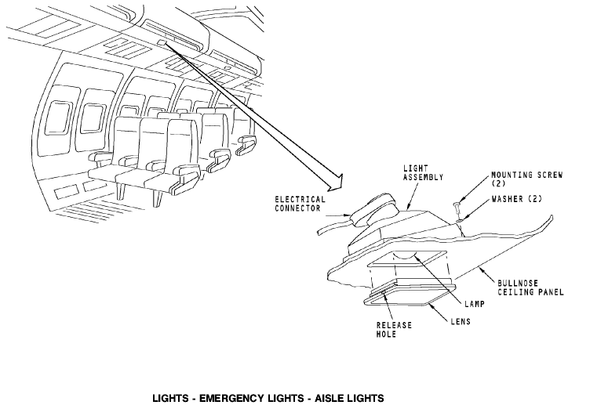

Slide 30
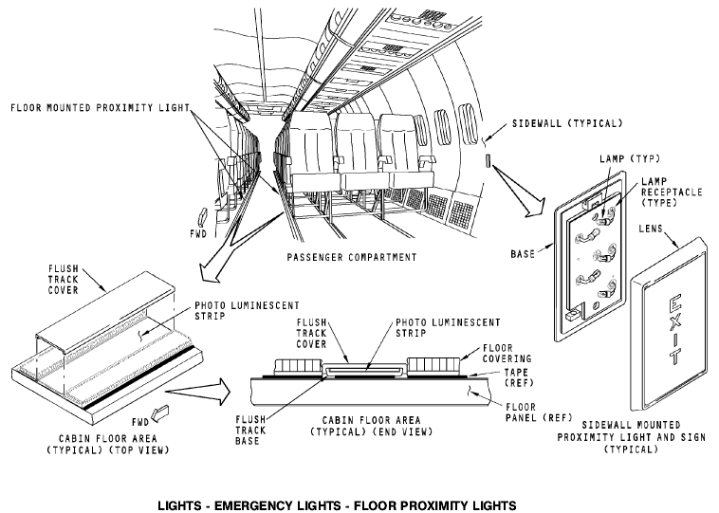

Slide 31
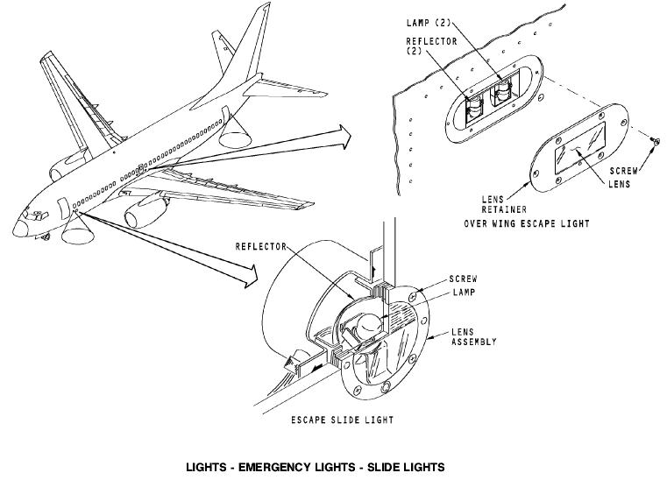

Slide 32
1.4 EMERGENCY LIGHTING continuation1
POWER SUPPLIES
The power supplies give power to internal and external emergency lights.
The power supplies have these components:
- Battery pack
- Test switch
- Electrical connector
- Control logic and charging circuit.
You use the emergency exit light switch on the P5 forward overhead panel or the emergency exit switch on the attendant panel. These switches control the emergency lights.

Slide 33
1.4 EMERGENCY LIGHTING continuation2
The emergency exit light switch on the P5 panel has these positions:
- ON : makes emergency lights come on;
- OFF: prevents automatic operation;
ARM: prepares system for automatic operation.
The NOT ARMED and MASTER CAUTION lights are on when the emergency light switch on the P5 panel is in the ON or the OFF positions. The 28V DC bus 1 supplies power to these indication lights.
The emergency exit switch on the attendant panel has two positions:
ON: makes the emergency lights come on.
NORMAL: sets automatic operation. The attendant panel switch will cause the lights to come on even if the P5 switch is OFF.

Slide 34
1.4 EMERGENCY LIGHTING continuation3
The power supplies use 28v dc for their charge and control logic circuits. The charge circuits charge the battery packs when these conditions occur:
P5 emergency exit light switch is in the OFF or ARM position
28v dc bus 1 has power
Attendant panel emergency exit light switch is in the NORMAL position.
When the P5 switch is in the ARM position, the power supply makes the emergency lights come on when one of these conditions occur:
- Attendant panel emergency exit switch is in the ON position.
- 28v dc bus 1 power drops less than 12 volts.

Slide 35
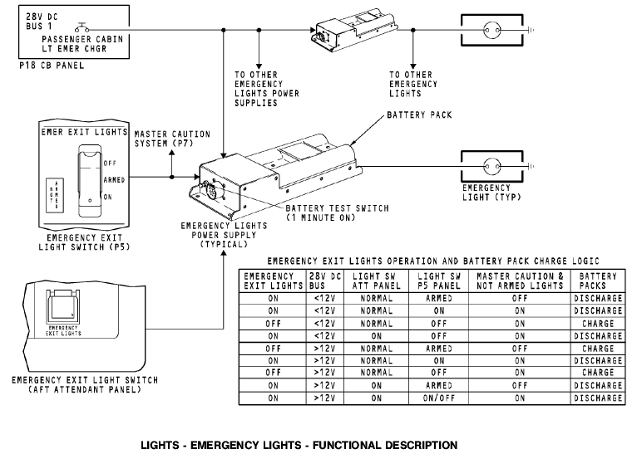

Slide 36
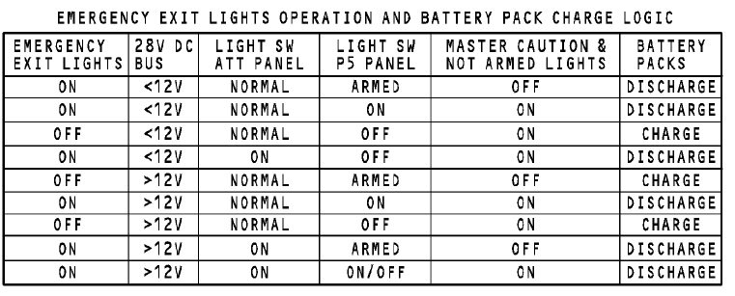

Slide 37
PART2 FIRE PROTECTION
TOPICS:
2.1 GENERAL
2.2 FIRE DETECTION SYSTEM
2.3 FIRE EXTINGUISHING SYSTEM
2.4 EXAMPLE

Slide 38
2.1 GENERAL
FUNCTIONS:
Fire is, of course, one of the most dangerous threats to an aircraft and so precautions must be taken to reduce the hazard, not only by the proper choice of materials and location of equipment in potential fire zones, but also by the provision of adequate fire detection and extinguishing systems.
The fire protection systems monitor the airplane for these conditions:
- Fire
- Smoke
- Overheat
Pneumatic duct leaks.
These systems may be broadly classified as two groups:
-fixed (eg.engine fire protection, cargo smoke detection, etc)
-portable (for use in the event of cabin fire,etc)

Slide 39
2.2 FIRE DETECTION SYSTEM
A fire detection system is installed mainly in engine compartments, APU compartment, wheel well, wing/body, cargo compartments, lavatory or other zone which is possible be affected by fire.
A fire detection system consists of special detecting elements strategically positioned within several fire zones designated by the aircraft manufacturer.
The elements, which may be of the “unit” or “spot” type or the “continuous” wire type, are connected to warning lights and/or bells, and either type may be used separately, in a combined fire warning and overheat system.
Unit type detectors are situated at points most likely to be affected by fire;
Continuous wire type detector system (known as “firewire” system) is normally used in order to provide maximum coverage of a fire zone and to eliminate.

Slide 40
2.3 FIRE EXTINGUISHING SYSTEM
Fixed fire extinguishing systems are used mainly for the protection of engine installations, auxiliary power units, landing gear wheel well bays, and cargo compartments, and are designed to dilute the atmosphere of the appropriate compartments with an inert agent that will not support combustion.

Slide 41
2.4 EXAMPLE
A TYPICAL AIRCRAFT FIRE PROTECTION SYSTEM
The airplane has these fire/overheat detection systems:
- Engine overheat and fire detection
- APU fire detection
- Wheel well fire detection
- Wing/Body overheat detection
- Cargo compartment smoke detection
- Lavatory smoke detection.
The airplane has these fire extinguishing systems:
- Engine
- APU
- Lavatory
- Cargo compartment
- Portable fire extinguishers.

Slide 42
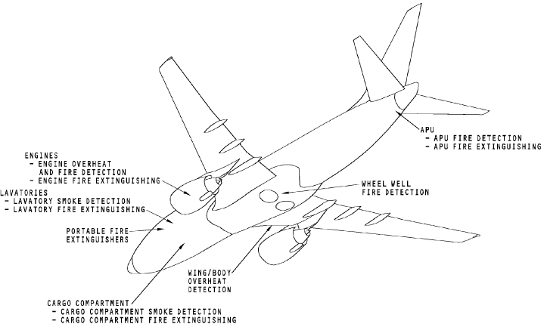
2.4 EXAMPLE
A TYPICAL AIRCRAFT FIRE PROTECTION SYSTEM continuation1

Slide 43
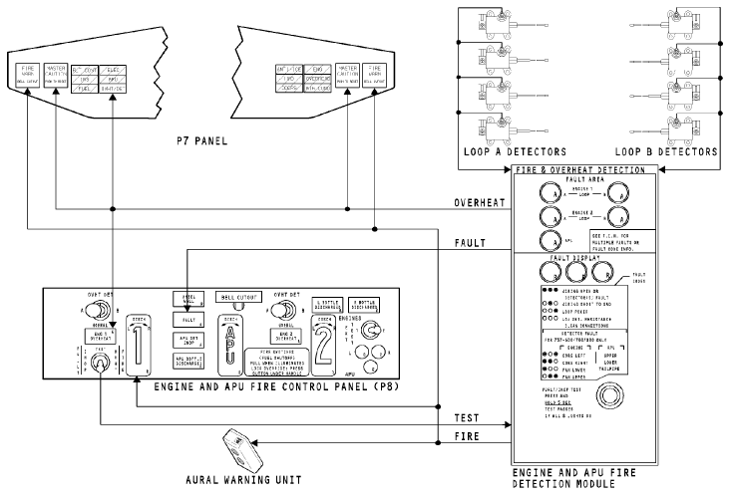
2.4.1 A TYPICAL AIRCRAFT ENGINE FIRE PROTECTION SYSTEM

Slide 44
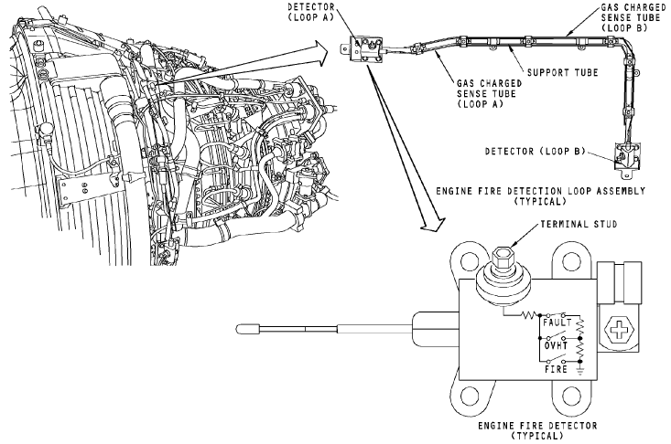
2.4.1 A TYPICAL AIRCRAFT ENGINE FIRE PROTECTION SYSTEM continuation1

Slide 45
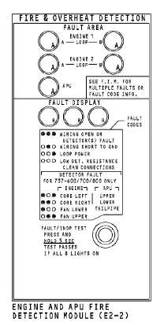
2.4.1 A TYPICAL AIRCRAFT ENGINE FIRE PROTECTION SYSTEM continuation2

Slide 46
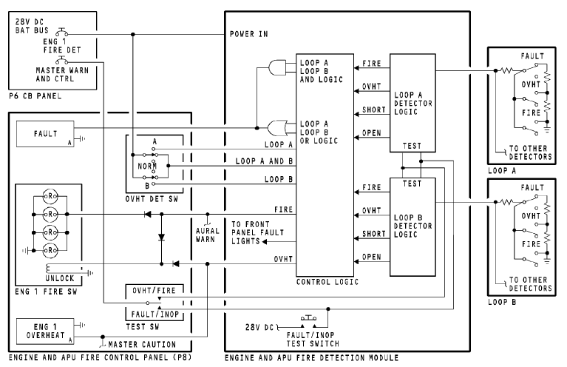
2.4.1 A TYPICAL AIRCRAFT ENGINE FIRE PROTECTION SYSTEM continuation3

Slide 47
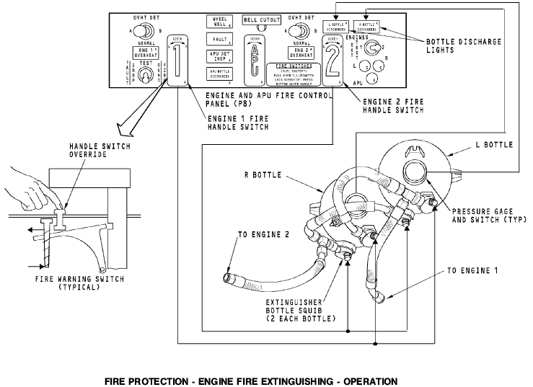
2.4.1 A TYPICAL AIRCRAFT ENGINE FIRE PROTECTION SYSTEM continuation4

Slide 48
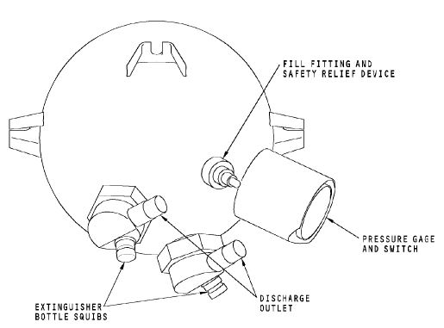
2.4.1 A TYPICAL AIRCRAFT ENGINE FIRE PROTECTION SYSTEM continuation5

Slide 49
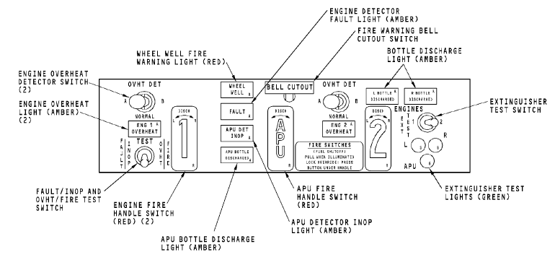
2.4.1 A TYPICAL AIRCRAFT ENGINE FIRE PROTECTION SYSTEM continuation6

Slide 50
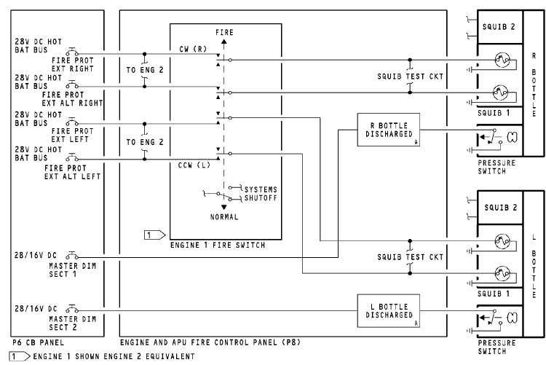
2.4.1 A TYPICAL AIRCRAFT ENGINE FIRE PROTECTION SYSTEM continuation7

Slide 51
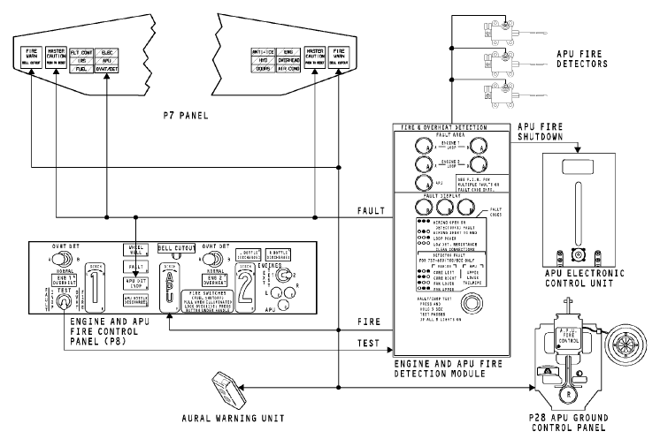
2.4.2 A TYPICAL AIRCRAFT APU FIRE PROTECTION SYSTEM

Slide 52
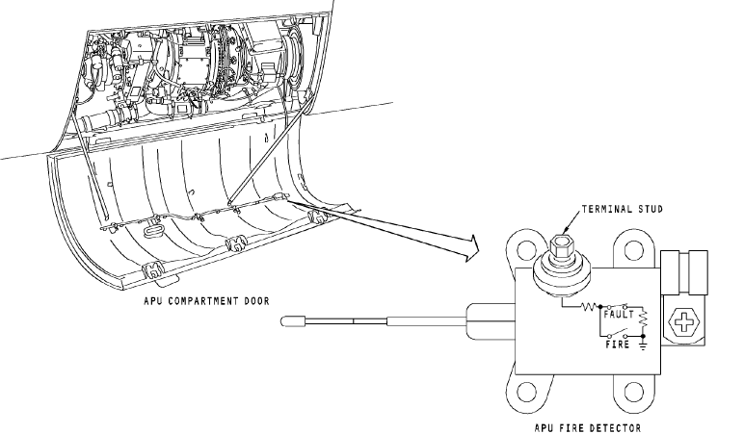
2.4.2 A TYPICAL AIRCRAFT APU FIRE PROTECTION SYSTEM continuation1

Slide 53
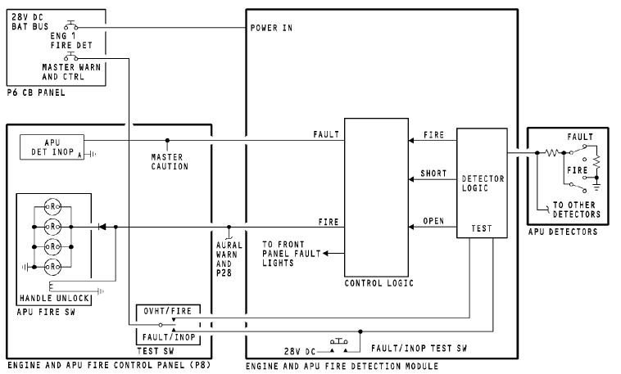
2.4.2 A TYPICAL AIRCRAFT APU FIRE PROTECTION SYSTEM continuation2

Slide 54
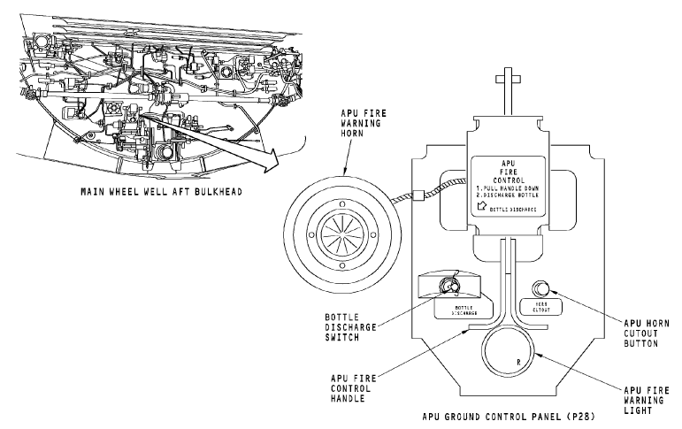
2.4.2 A TYPICAL AIRCRAFT APU FIRE PROTECTION SYSTEM continuation3

